Slide 1
Octiocor

Slide 2
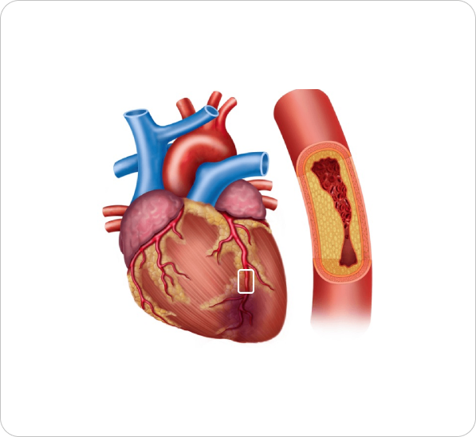
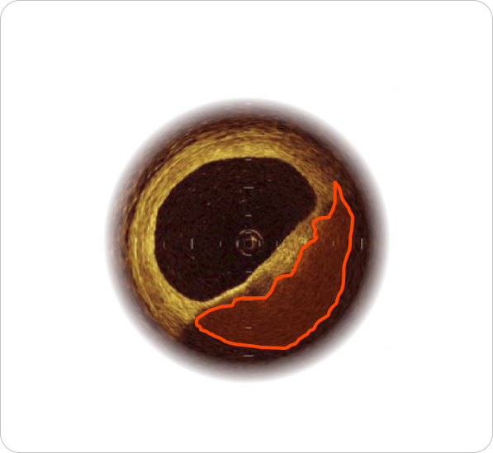
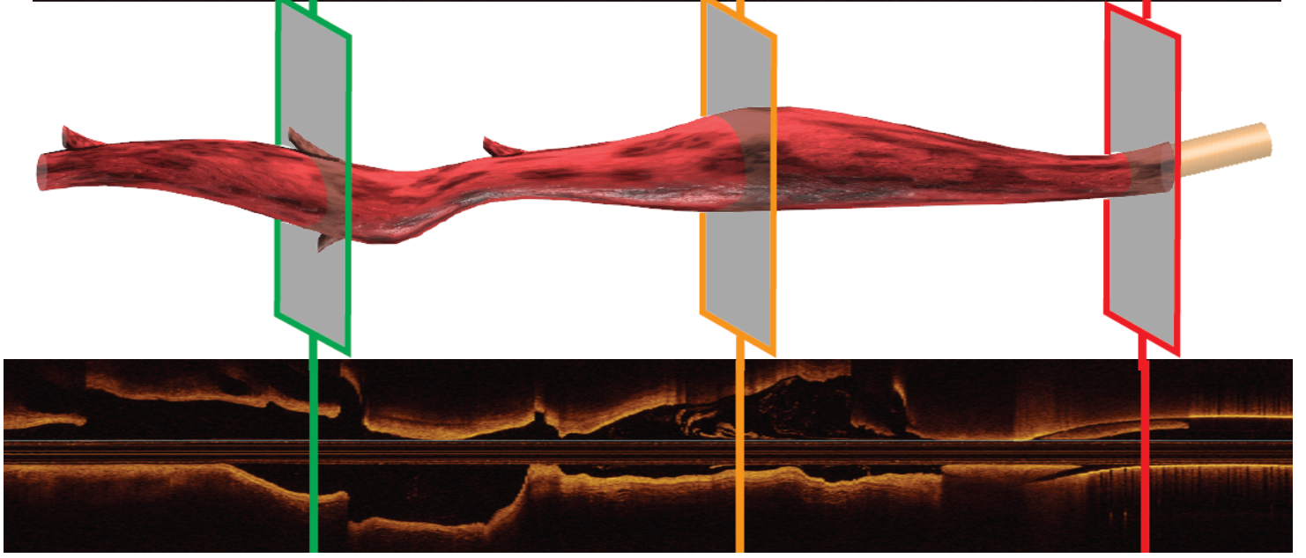
What do the company do?
Analyse images of coronary arteries taken from inside the artery.
Used to track disease status and guide stenting.
Intracoronary optical coherence tomography (OCT) has 10-15μm resolution.
Allows for study of fine details in arteries and recommended by US, EU and Japanese guidelines.

Slide 3
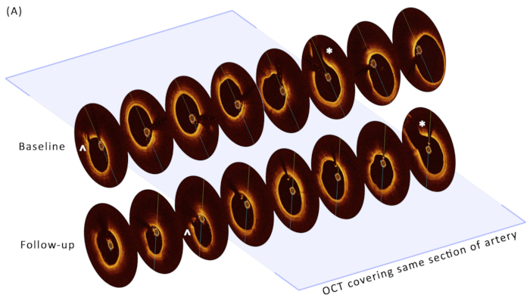
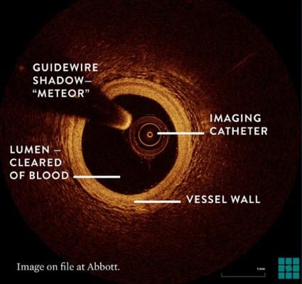
What is the problem?
The images are large 1024 x 1024 x 500 pixels.
They are acquired during the heartbeat: lots of artefacts.
The start and end of baseline and follow-up images is different.
Tracking disease changes requires aligning images in 3D, but this is very slow.

Slide 4
What is needed?
For each frame in each image, we would like to know:
where the corresponding frame is in the follow-up
correct for longitudinal stretch
correct for rotational and scaling distortions.
We also need to mask known artefacts in the images during registration.

Slide 5
Vet.CT

Slide 6
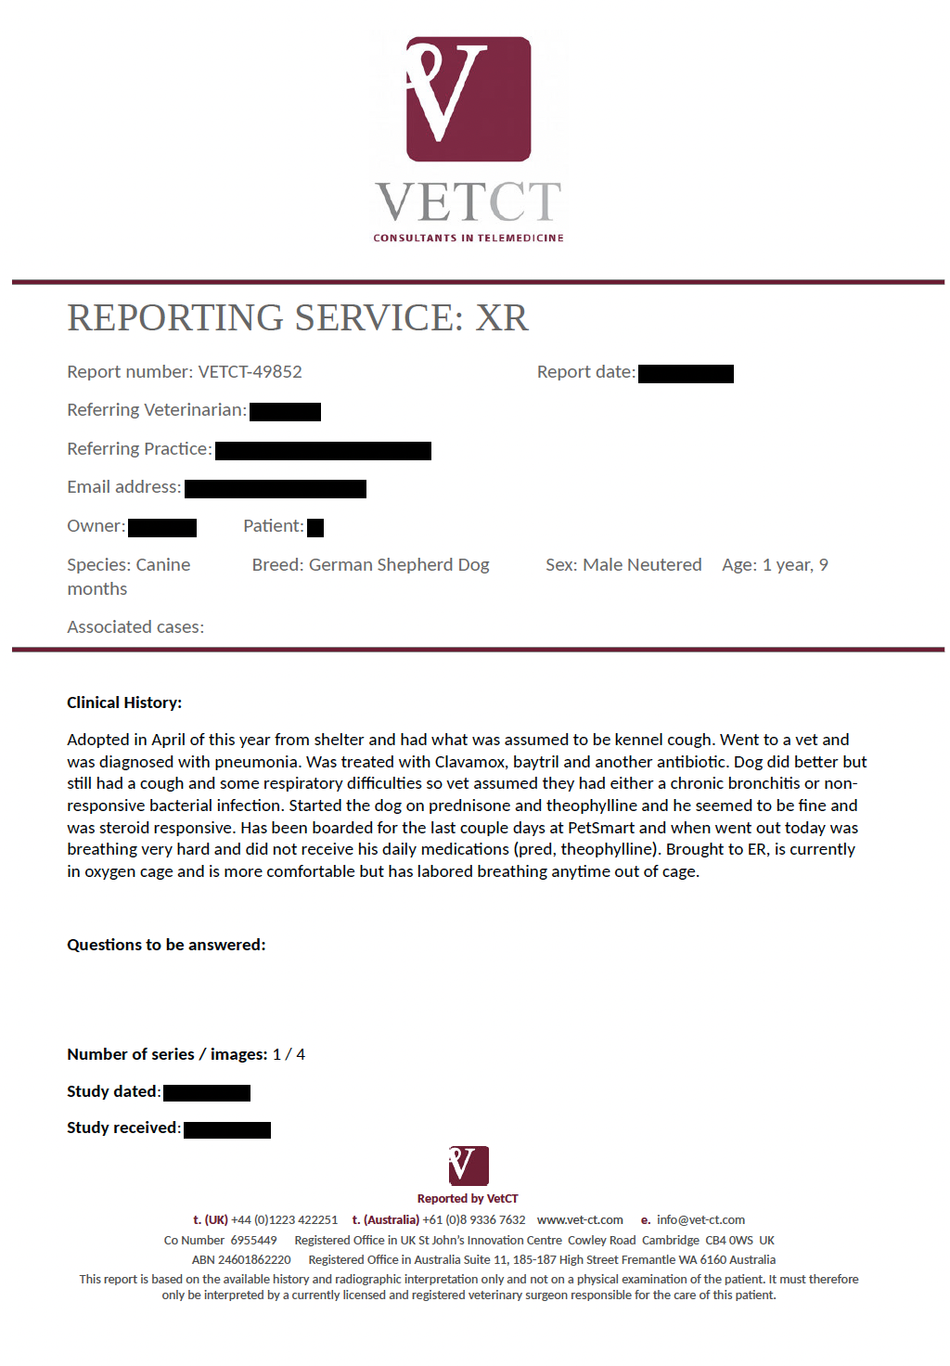
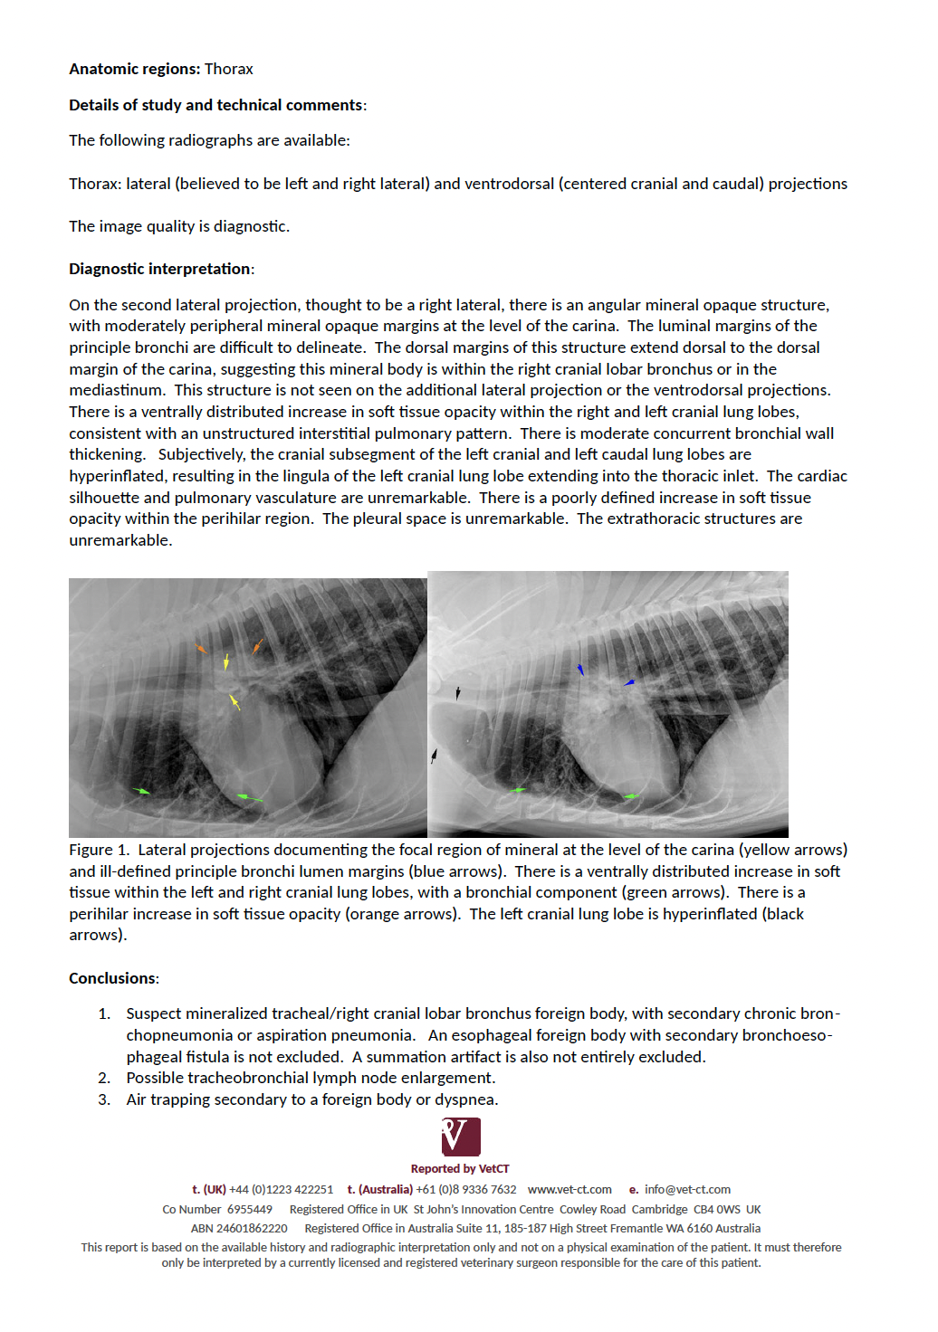
What does the company do?
Links veterinary practices to remote radiologists who analyse their images.
Radiologists prepare reports for patients, with turnaround times of 1 hour - 4 days.
These reports have text descriptions of issues with the images, along with screenshots and markers.

Slide 7
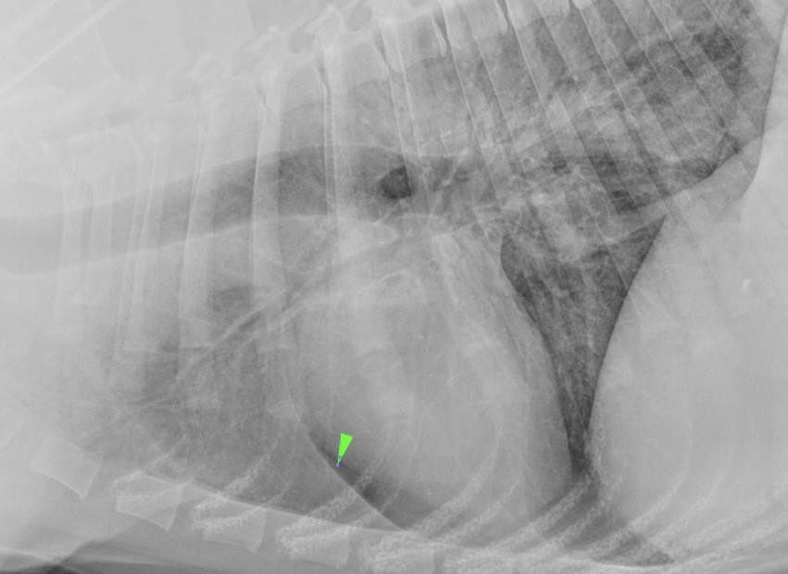
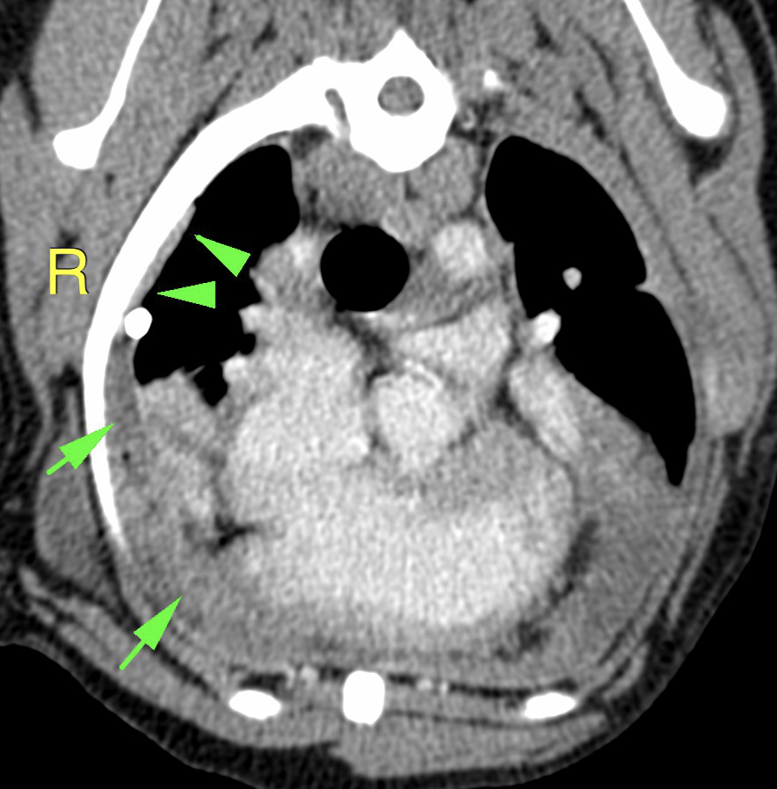
What is the problem?
The images in the reports are static objects and markers can’t be used for analysis.
The company would like to get the coordinates of markers in the original files.
Chest X-rays are 2D and CTs are 3D. We want to extract the images from the PDFs, extract the markers from the images and align with the images.

Slide 8
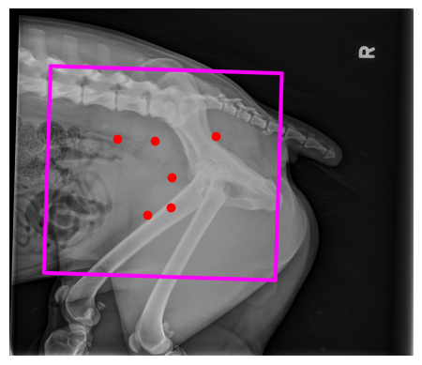
What is needed?
Would like a pipeline for extracting images from the PDFs and identifying (i) the original DICOM images and (ii) the coordinates.
For CXR (2D) and CT (3D) with custom reconstructions.

